Slide 1
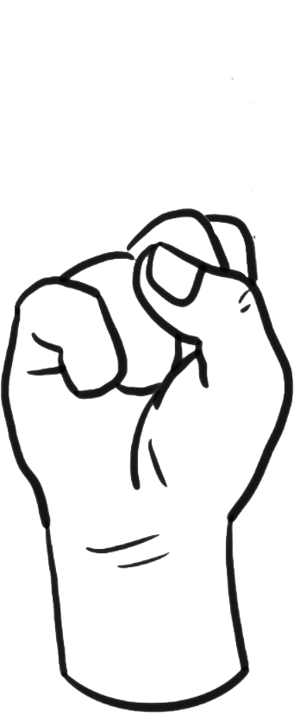
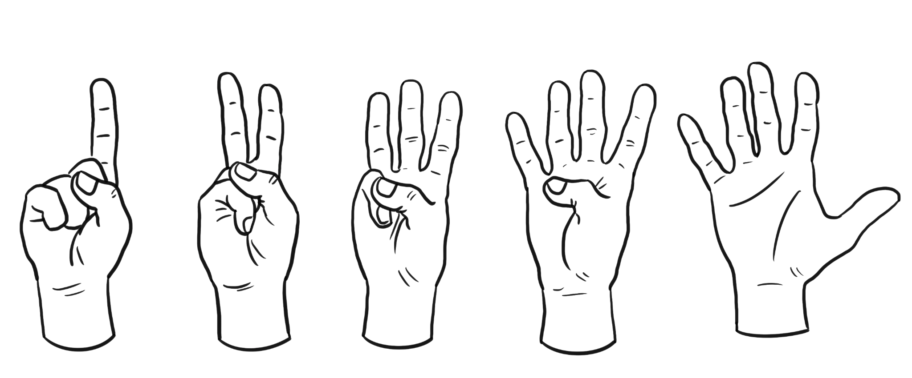
Using two-way tables to display outcomes for two events
Task A: Outcome table from a two-stage trial
1) This spinner is going to be spun twice as part of a two-stage trial. Complete the outcome table to show all the possible outcomes.
A
B
C
A
C
A
AA
AB
AC
B
B
BA
BB
BC
C
CA
CB
CC
2) Both spinners are going to be spun as part of a two-stage trial. Complete the outcome table to show all the possible outcomes.
1
2
A
C
A
A1
A2
B
1
2
B
B1
B2
C
C1
C2
3) Laura and Izzy are playing a game of ‘rock, paper, scissors’. Where rock beats scissors, scissors beats paper and paper beats rock.
Complete the outcome table to show when each person wins.
Laura
1
2
rock
paper
scissors
rock
no one
Laura
Izzy
Izzy
paper
Izzy
no one
Laura
scissors
Laura
Izzy
no one

Slide 2









Using two-way tables to display outcomes for two events
Task B: Outcome table from two events
1) The spinner will be spun. The two events are even numbers and factors of 14.
Complete this outcome table to show the outcomes for each event.
1
8
2
7
3
6
even numbers
odd numbers
4
5
factors of 14
2
1
7
not factors of 14
4
6
8
3
5
2) Sort these drinks into the outcome table.
A
B
C
D
E
F
G
H
I
handle
no handle
straw
B
C
F
I
D
E
H
no straw
A
G

Slide 3

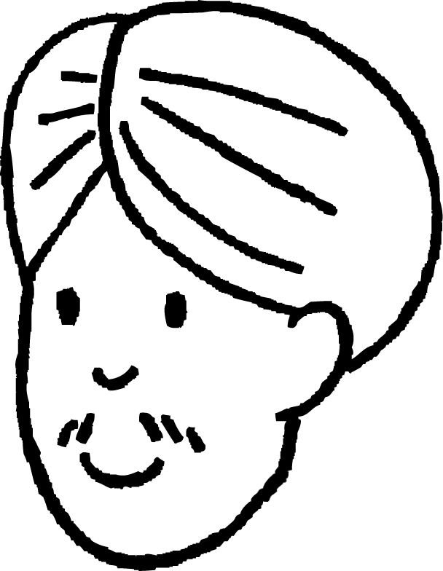
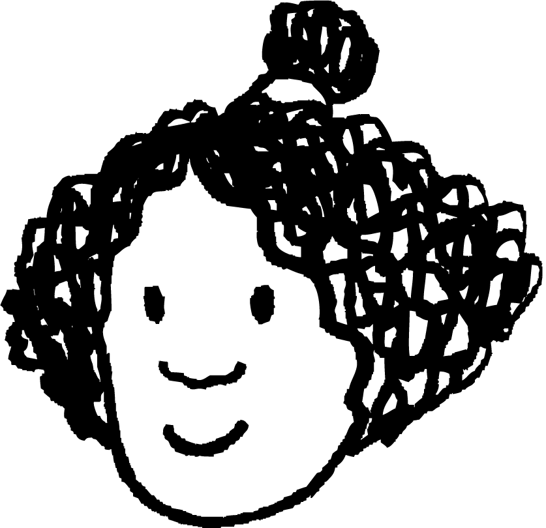
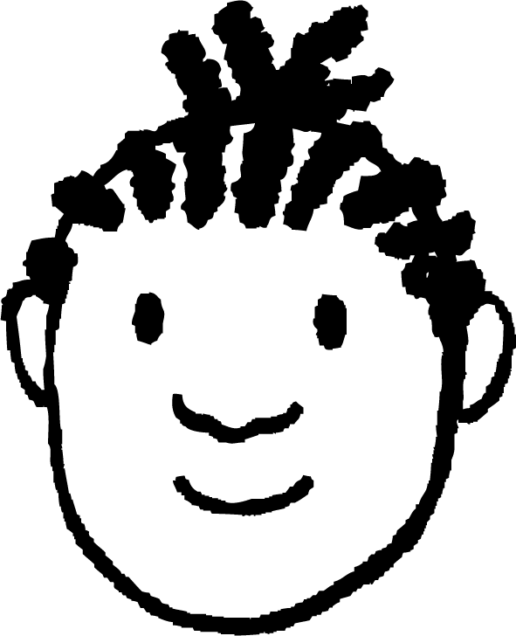






Using two-way tables to display outcomes for two events
Task C: Frequency in a two-way table
1) A random sample of people is being selected by allocating an integer from 1 to 50 to each person and then picking based on two rules. Rule 1 is that the integer is a multiple of 10 and rule 2 is that the integer is a multiple of 4.
Complete the two-way table.
multiple of 10
not a multiple of 10
total
multiple of 4
2
10
12
not a multiple of 4
3
35
38
total
5
45
50
2)
Aisha | Music | Sport
Andeep | Music
Izzy
Jacob | Sport
Jun | Music | Sport
Lucas | Music | Sport
Laura | Music
Sam | Music
Alex | Sport
Sofia | Music
10 pupils have been asked about whether they are members of a sports or music club.
a) Circle all the numbers in the table that include Izzy.
b) Which clubs does Sofia do, if any?
sports club
no sports club
total
music club
3
4
7
no music club
2
1
3
total
5
5
10
3)
Fill the missing boxes on each of these two-way tables.
a)
b)
 | 1st attempt | 2nd attempt | total
pass | 12 | 10 | 22
fail | 16 | 6 | 22
total | 28 | 16 | 44
 | child | adult | total
goggles | 18 | 5 | 23
no goggles | 9 | 31 | 40
total | 27 | 36 | 63
Mathematics in Education and Industry
v2.3

